Slide 1
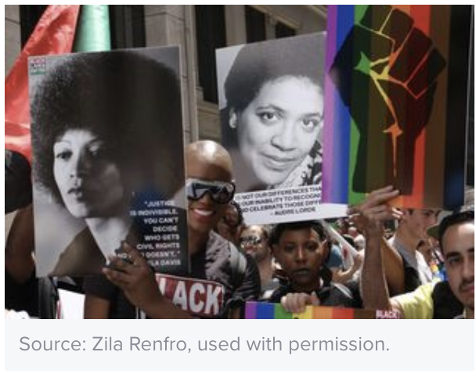
Equity Through the Arts: Change Starts With/In Us A Dialogue Across Identities
Stephen Brookfield, Ph.D.
Bryana H. French, Ph.D.
University of St. Thomas

Slide 2
Continual Audience Participation Backchannelchat.com
Log
Please log into www.BackChannelChat.com
Create
Create an ID using ONLY NUMBERS – no names, nicknames etc. Use your birthdate, favorite year, etc.
Enter
Enter the code: vrx49
Type
Type in a greeting so we know it works
Notes:
BRYANA WILL DO THIS AND SET UP THE AUDIENCE
THEN STEPHEN WILL COME IN

Slide 3
Perspectives on Arts in Social Justice Pedagogy
This Photo by Unknown Author is licensed under CC BY-SA-NC
Art as healing justice
Herbert Marcuse
Notes:
The ‘healing justice’ approach combines social justice organizing with healing circles, spirituality, and the arts for individual and community healing, expression and empowerment (Ginwright). Art can speak truth to power, raise consciousness, and heal personal-collective wounds (Hocoy)
Marcuse: True liberation from dominant ideologies (white supremacy) comes only when people immerse themselves in an artistic experience
This opens up a sensuous awareness of how life can be experienced differently. Threatens status quo the most – can’t control it
Our presentation is an example of artistic expression.
5 minutes each

Slide 4
DISCUSSION
HOW DO YOU USE ART TO ADVANCE EQUITY WORK?
BackChannelChat.com
Notes:
END AROUND 9:40PM

Slide 5
White Supremacy and Patriarchy as Cultural Frames
bell hooks: interlocking systems of domination as “imperialist White supremacist capitalist patriarchy”
White Supremacy: embedded in how institutions work, assumptions that Whites should ‘naturally’ be in positions of power & have the responsibility of making decisions for the rest of us
Substitute ‘men’ for Whites & ‘women’ for People of Color & you have a definition of Patriarchy
Notes:
bell hooks refers to interlocking systems of domination as “imperialist White supremacist capitalist patriarchy”
These systems can be practiced and supported, as well as challenged and resisted, by anyone
How we Experience White Supremacy as a Cultural Frame in the U.S.
Successfully socialized - biases and normalized Whiteness in institutions
Biases around scholarship, linearity, rigor, - internalized messages of inferiority
Developing awareness
Focusing on white supremacy VS, Diversity or cultural competence
White Supremacy – the idea, embedded in how institutions work, that whites should ‘naturally’ be in positions of authority and power & have the responsibility of making decisions for the rest of us
This is because whites are assumed to be more intelligent, more logical, capable of thinking more objectively & analytically. People of color are assumed to be too impulsive, lack self-control & governed my emotions not logic.
Substitute ‘men’ for whites & ‘women’ for people of color & you have a definition of patriarchy
GIVE EXAMPLES

Slide 6
White Supremacy and Patriarchy in Action
Equity work often diverted to focus on inclusion & diversity without focusing on oppressive hegemonic actions & structures.
Notes:
The real problem is how white supremacy functions & is reproduced everyday, & how a white epistemology of rationality, quantification, text, linearity controls education.
How people are rewarded for what people do –
What we as educators want to do is get people to think more structurally.
Give examples

Slide 7
Discussion
HOW DO YOU GET STUDENTS TO BECOME AWARE OF SYSTEMS OF OPPRESSION?
Think – Pair – Share
Notes:
End around 10:00
Share wisdom on BackChannelChat.com

Slide 8
Our Educational Practice
Creating a culture for conversation
Narrative disclosure to model openness
Cross racial team teaching
Mandating a space for all to be heard
Ethical use of teacher authority to create productive dissonance
Crucial importance of institutional administration support
Notes:
Pedagogy
Racial consciousness raising (needing to help students get to a place of readiness to have this conversation)
Importance of cross racial conversations (challenge of POCI bearing their soul, risking microaggressions,
How to develop this
Nuggets
Mandate a space for everyone to speak and be heard - rethink what class discussion looks like
Modeling vulnerability and growth
Team teaching properly with a certain level of racial consciousness
Create dissonance – by Moving beyond comfort zone
Need for administrative support and focus on White supremacy: Ability to push back on curriculum, challenge oppressive structures,

Slide 9
Selected References
Brookfield, S. and Associates (2018). Teaching Race: Helping Students Unmask & Challenge Racism. San Francisco, CA: Jossey-Bass.
Brookfield, S. & Preskill, S. (2017). The Discussion Book: 50 Great Ways to Get People Talking. San Francisco, CA: Jossey-Bass.
Brookfield, S. & Hess, M. (In Press). Creating an Anti-Racist White Identity. Stylus
French, B. H. et al. (2019). Toward a psychological framework of radical healing. The Counseling Psychologist.
Hooks, B. (1994). Teaching to Transgress. New York, NY: Routledge.
Marcuse, H. (1978) The Aesthetic Dimension. Boston: Beacon Press

